Slide 1
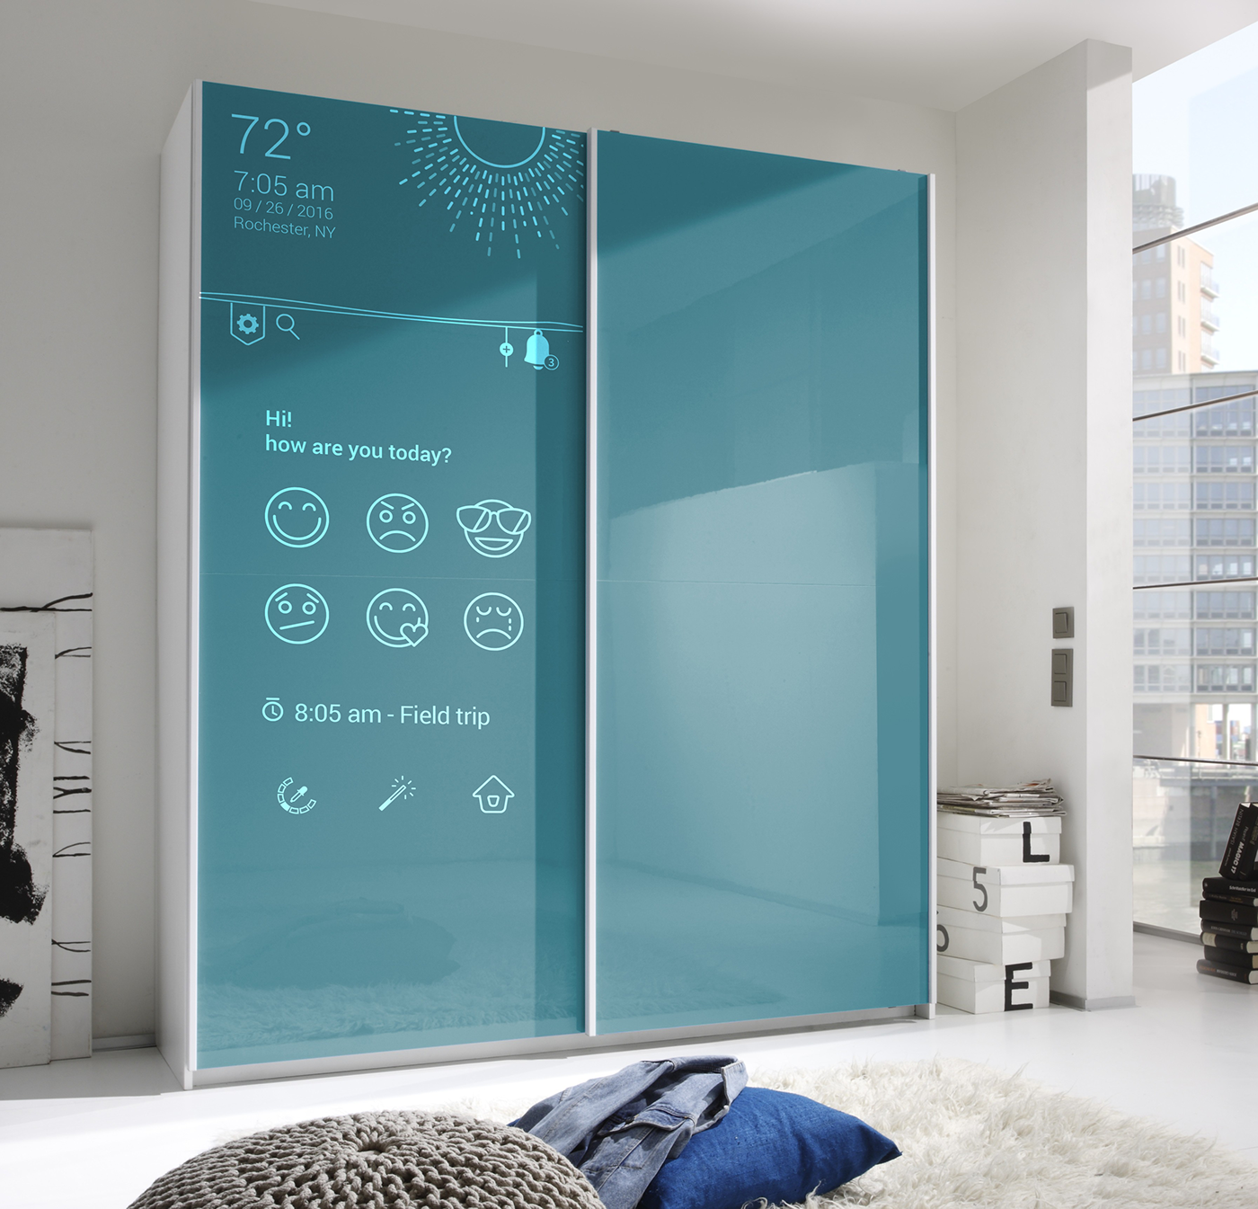

Smart Cabinet Project
Link to Nisim’s GitHub
Link to Refael’s GitHub
Created by
Nissim Amira 307831388 Refael Rubinov 315790246

Slide 2
Introduction
Project Overview
Market Demand
Smart Home Integration
A cabinet that will warn against humidity and unwanted temperatures in addition to convenient and efficient use.
Made for people who seek for innovative solutions to simplify their lives and enhance convenience.
Exploring the integration of the smart cabinet with modern smart home technology.

Slide 3
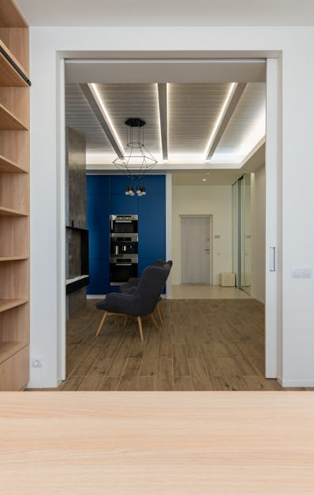
Smart Cabinet Features
Humidity & Temperature Sensor
Smartphone Connectivity
Shows in real time the level of humidity and temperature
Real-time viewing of temperature and humidity data in the application.
Light Control
On/Off
Switching the light On/Off from a physical on cabinet switch.
Turning on and off the light when opening and closing the door or with a switch.
Photos provided by Pexels

Slide 4
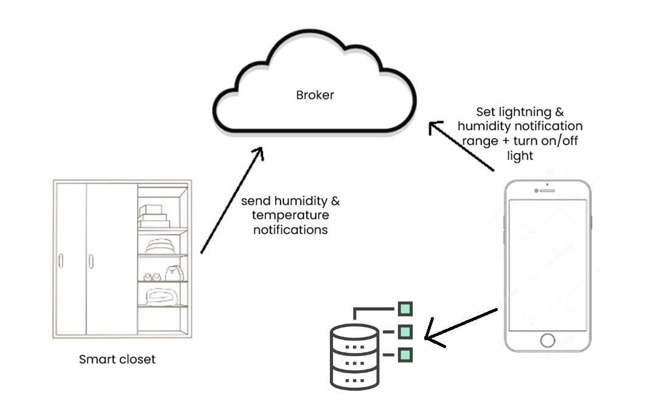
Design & Architecture
Sensors publish data and the application acts accordingly.
According to the defined humidity and temperature range, the system sends an alert when the range is exceeded.
Viewing of the notifications and the sensors data on a mobile app.
Saves data to SQLite DB

Slide 5
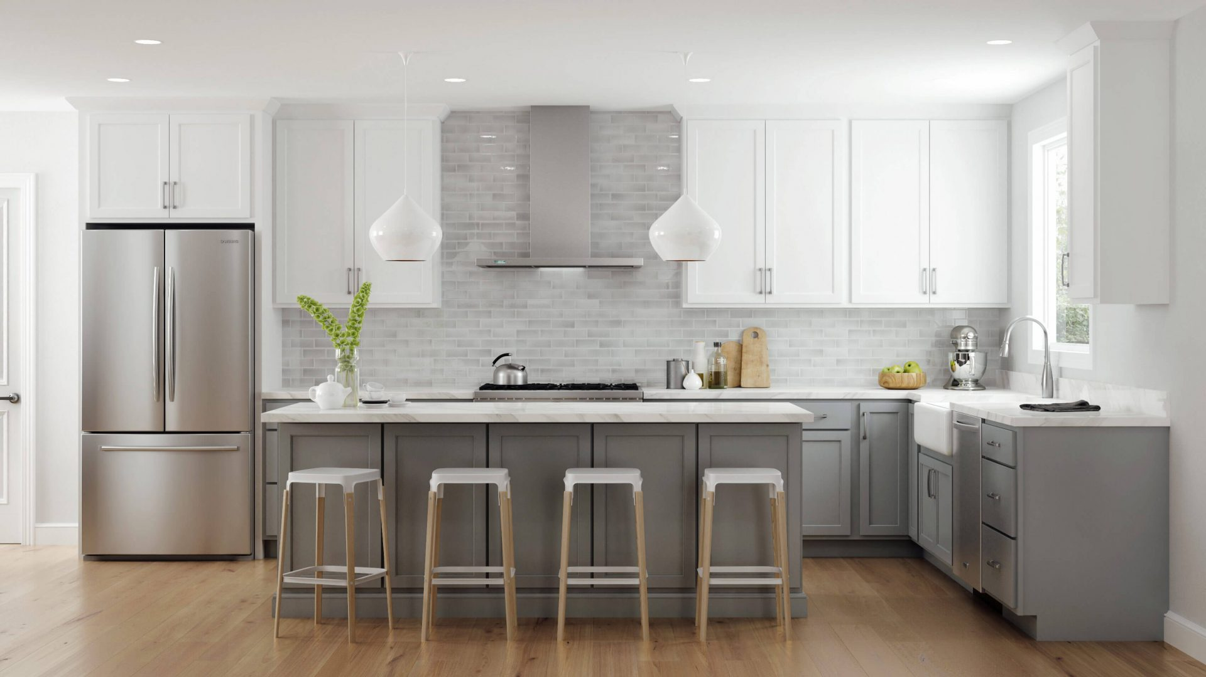
Targets
Prevent unwanted moisture in cabinets to avoid damage caused by humidity or high temperature.
Provide real-time alerts to users about high humidity levels to prevent potential damage to stored items.

Slide 6
Design & Development Conceptions:
Proactive Prevention: Our focus was on anticipating and preventing damage by alerting users to high humidity and temperature levels before problems arise.
Real-Time Monitoring: We designed the cabinet to continuously monitor conditions, providing users with up-to-date information for immediate action.
User-Centric Design: Every aspect was crafted with user experience in mind, ensuring intuitive control through the mobile app and seamless integration of hardware and software.
Seamless Integration: Our goal was to create a cohesive system where sensors, controls, and the mobile app work together flawlessly to deliver accurate data and timely alerts.

Slide 7
Design & Development Steps:
Purchase and assembly of DHT sensors to individual cabinets
Purchase cloud platforms of MQTT brokers and DB server
Develop programs:
1. Program that reads sensors data and publishes it via MQTT as well as subscribes to the MQTT broker. 2. Mobile app that subscribes and publishes to the MQTT broker, receives notification.
4. Test and integrate the hardware and software into a working product.

Slide 8

Main modules
DHT Sensor module
Mobile app module
Light control module
Door sensor module
Photos provided by Pexels

Slide 9
Functionality & Flow
Monitoring and Alerting
Functionality:
- The system continuously monitors temperature and humidity levels.
- If levels exceed predefined thresholds, an alert is sent to the mobile app.
Flow:
1. Sensors measure conditions.
2. Microcontroller checks data.
3. If abnormal, alert sent to mobile app.
4. User receives notification and can take action.
Light Control
Functionality:
- Users control cabinet light via on cabinet button.
- Cabinet light turns On/Off automatically when the door opens or closes.
Flow:
1. Opening the door sends massage.
2. app sends command to turn on the light.
3. Closing the door sends massage.
4. app sends command to turn off the light.
Photos provided by Pexels

Slide 10

Conclusion
Our smart cabinet addresses the challenge of maintaining optimal storage conditions by continuously monitoring temperature and humidity levels and providing real-time alerts to users, thus preventing potential damage to stored items.
In summary, our IoT smart cabinet offers proactive monitoring, remote control capabilities, and user-friendly interface, enhancing the storage experience while ensuring the safety of stored items. With the integration of IoT technologies, we have created a reliable and efficient solution for modern storage challenges.
We utilized an Mobile app as the central device to collect sensor data, process information. Additionally, we employed MQTT protocol for efficient data exchange between the sensors and the mobile app

Slide 11
Bibliography
Github - Yury Yurchenko - Smart Home

